Slide 1

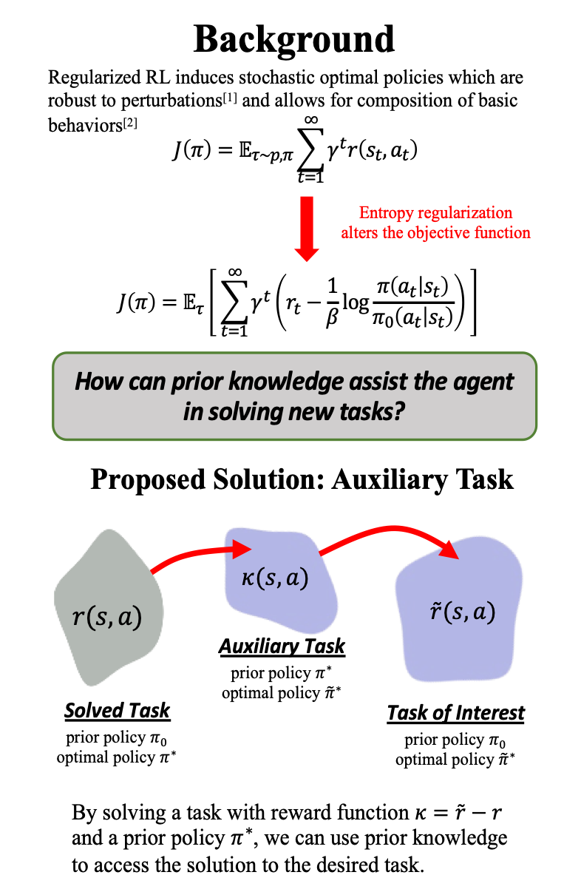
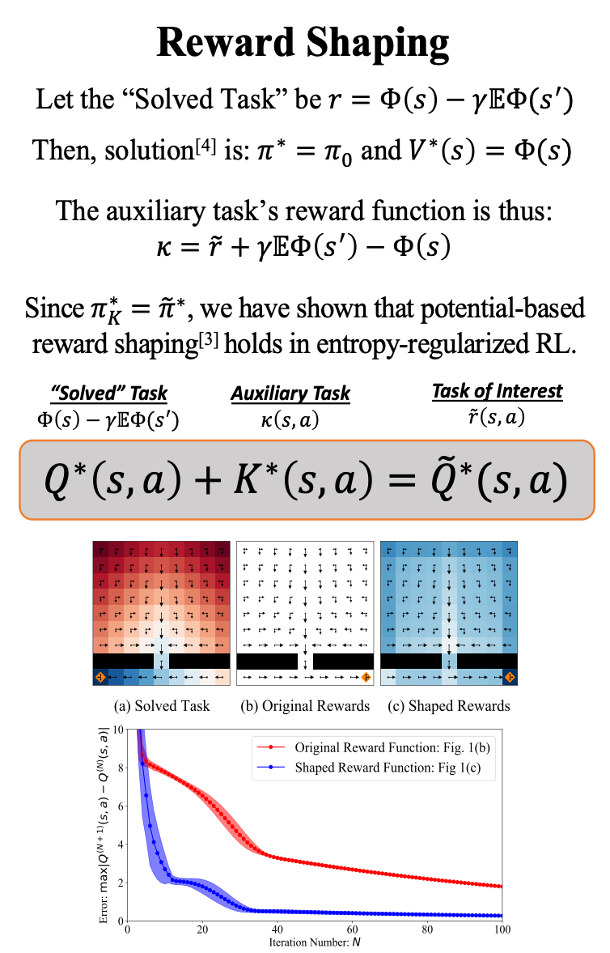

Utilizing Prior Solutions for Reward Shaping and Composition in Entropy-Regularized Reinforcement Learning
Jacob Adamczyk,¹ Argenis Arriojas,¹ Stas Tiomkin,² Rahul V. Kulkarni¹
¹Dept. of Physics, University of Massachusetts Boston, ²Dept. of Computer Engineering, San Jose State University
Abstract
In RL, the ability to utilize prior knowledge from previously solved tasks can allow agents to quickly solve new problems. In some cases, these new problems may be approximately solved by composing the solutions of previously solved primitive tasks. Otherwise, prior knowledge can be used to adjust the reward function in a way that leaves the optimal policy unchanged but enables quicker learning. In this work, we develop a general framework for reward shaping and task composition in entropy-regularized RL.
Add your information, graphs and images to this section.
Introduction
Conclusions & Future Work
We have developed a systematic method for re-using old solutions for solving new problems more efficiently, via an “auxiliary” corrective task.
~
In future work, we propose learning the optimal composition function given pre-trained skills.
Reinforcement Learning (RL) is a machine learning method for solving sequential decision-making problems (e.g. board games, robotic manipulation)
References & Acknowledgements
[1]: “Maximum Entropy RL (Provably) Solves Some Robust RL Problems”, B. Eysenbach, S. Levine (2022); arXiv: 2103.06257
[2]: “Composable Deep Reinforcement Learning for Robotic Manipulation”, T. Haarnoja, et. al. (2018); arXiv: 1803.06773
[3]: “Policy invariance under reward transformations: Theory and application to reward shaping”, Ng, Harada, Russell, ICML 1999
[4]: Identifiability in inverse reinforcement learning”, H. Cao, S. N. Cohen, Ł. Szpruch; arXiv:2106.03498
[5]: “Composing Entropic Policies using Divergence Correction”, J.J. Hunt, et. al. (2019); arXiv:1812.02216
This work was supported by the National Science Foundation through Award DMS-1854350, the Proposal Development Grant provided by the UMB the CSM Dean’s Doctoral Research Fellowship through fellowship support from Oracle, project ID R20000000025727, the Research Foundation at San Jose State University, and the Alliance Innovation Lab in Silicon Valley.
https://openai.com/research/solving-rubiks-cube

